Slide 1
Loan Fault Prediction
Yingyin(Ashley) Xiao

Slide 2
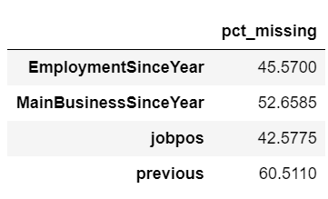
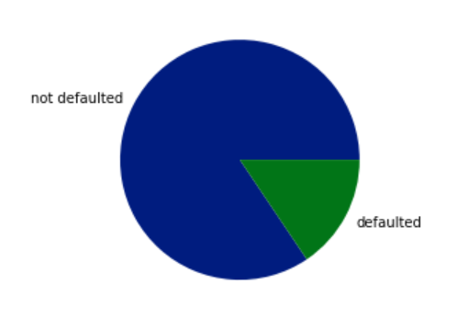
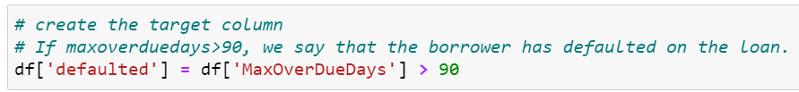
Preliminary Study
Dataset: 'sample_200_0k_20170120.csv'
1
Dropped because the percentage of missing is too large. Imputation will not represent the data
Converted to a binary feature (1 if previous loan record existed)
2
Created the target column “defaulted” (if the loan defaults), and we see the data is unbalanced
Used under-sampling to rebalance the data

Slide 3
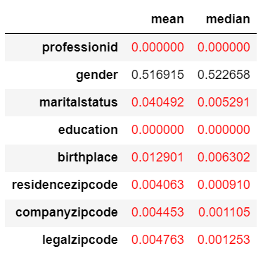
Categorical Features
Performed a Chi-squared test to see if the categorical features are statistically significant to the target “defaulted”, the red indicating p value < 0.05.
We conclude that these categorical features in red are statistically significant in determining if a loan will be defaulted.

Slide 4
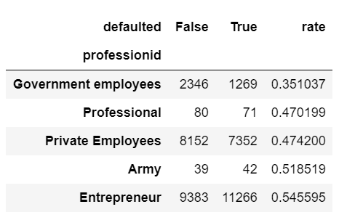
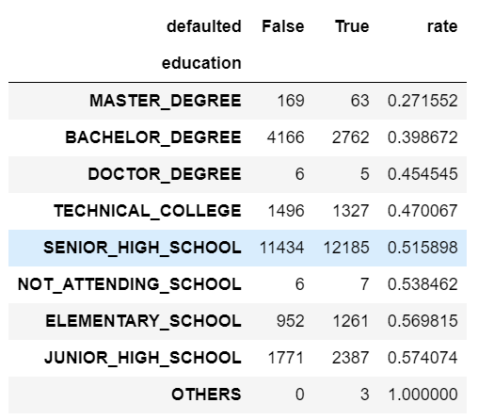
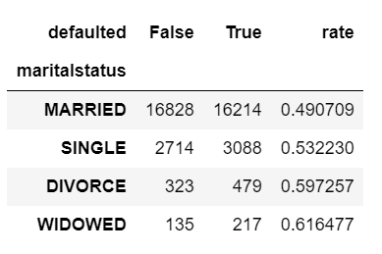
Insights on default by categories
Entrepreneur tend to have a higher default rate, which makes sense because business involves high risks.
People with higher education tend to have lower default rate.
Married people have lower default rate.

Slide 5
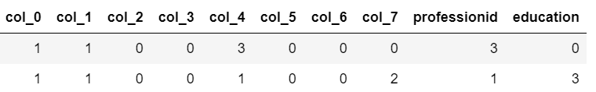
Feature Engineering
Label Encoder
professionid
education
Hash Encoder
Maritalstatus
Birthplace
Legalzipcode
Companyzipcode
Residencezipcode
Label encoder: ordinal features
Hash encoder: Good for features with high dimensions
We then append all the quantitative features with the encoded categorical features above.

Slide 6
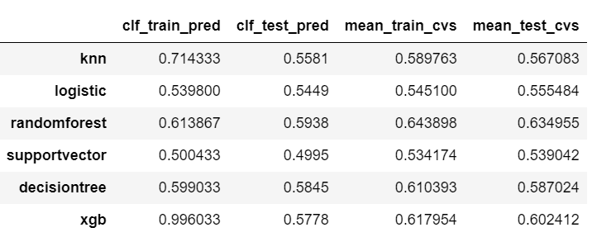
Model
Prediction of the training set
Prediction of the test set
XGBoost, KNN, and SVM take too long to run, so we don’t take them into consideration.
Random forest classifier performs the best will, we examine it further.
The mean training roc_auc_score of 5 cross-validated samples using each classifier

Slide 7
Model improvement
Hyperparameter tuning
We test (max_depth [5~10], min_samples_leaf [1~4]) of the random forest classifier and see that when max_depth = 7, min_samples_leaf = 2, the tree performs the best
Filter quantitative features
Select 15 best quantitative features of importance using Chi-squared test (compute the stat between each non-negative feature and class(1,0 in defaulted)) and RFE (recursive feature elimination)
Both methods returned the same 15 features

Slide 8
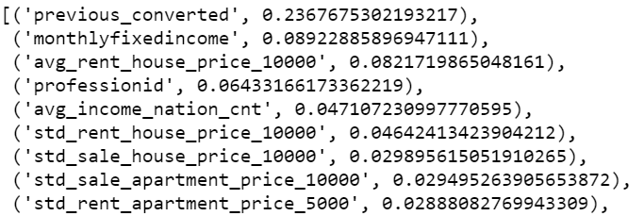
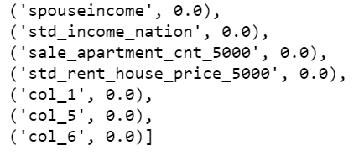
Model improvement
Remove trivial features of importance
(feature, importance); importance summed up to 100%
Previous_converted: 1 if the person has pervious loan record 0 otherwise
Contributed most to if the loan will default
…
Removed because the importance is close to 0

Slide 9
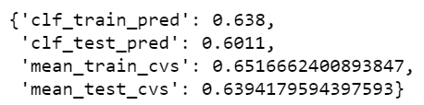
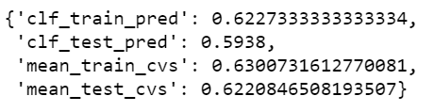
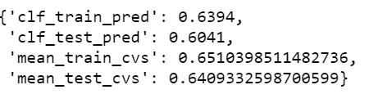
Model improvement
Original result
(max_depth = 5, min_samples_leaf = 2)
Hyper-parameter tuning
Filter quantitative features
Remove trivial features of importance
Improved
Not improved
Improved

Slide 10
Potential drawback
Under-sampling
Under-sampling is achieved by decreasing the amount of samples in the majority group to balance with the minority group. Therefore, under-sampling is likely to miss meaningful information.
Too many quantitative features
Noisy dataset might lead to a classifier bias

Slide 11

Runtime
The runtime to construct a random forest is O(n_tree*mnlog(n)), n_tree denotes the number of trees, n denotes number of records, m denotes number of variables you want to sample at each node
Actual runtime of random forest classifier in seconds
It makes sense to have a larger training time than testing because training size is much larger than the test size.
Runtime of the whole program in seconds

Slide 12
Future work
Compare under-sampling, oversampling and bagging to see which one results in better model performance
Reduce the size of quantitative features
Feature engineering on important features, such as “previous”
Tune more hyperparameters in the random forest, such as n_estimators

